Slide 1


Hand Landmark Detection
Hand Landmark Detection Experiments
Aug 16th~18th, 2023
To. professor

Slide 2
Hand Landmark Detection
Index_
1. Introduction of dataset for experiment
2. Evaluation Metric for Object Detection - (YOLOv5, SSD-MobileNet)
3. Comparison the results

Slide 3
Hand Landmark Detection
1. Introduction of dataset for experiment

Slide 4


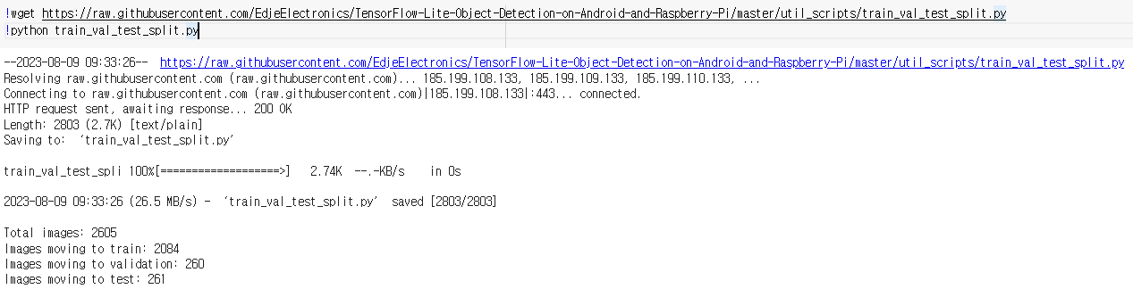
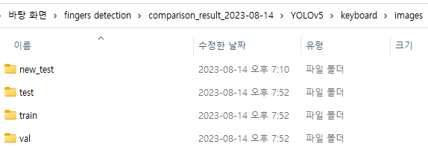
1. Introduction of dataset for experiment
There are 2,605 images from divided in 5 technique related videos.
First, I split dataset 8:1:1 for train, test, and val respectively using “train_val_test_split.py” founded by searching on GitHub.
Next, I downloaded these data files in my computer. Then, these are moved to YOLOv5 folder so that train the model for same data.
1

Slide 5
2. Evaluation Metric for Object Detection
- (YOLOv5, SSD-MobileNet)

Slide 6
2. Guidance on experimental procedures
YOLOv5
I obtained an evaluation metric for object detection according to IoU threshold using val.py provided.
Used IoU threshold are 0.5, 0.6, 0.7, 0.8, 0.9 and 0.95.
SSD-MobileNet
I obtained an evaluation metric for object detection according to IoU threshold using calculate_map_cartucho.py founded by searching on GitHub.
Used IoU threshold are from 0.5 to 0.95 in increments of 0.05.
2

Slide 7
2. Evaluation Metric for Object Detection
- YOLOv5

Slide 8
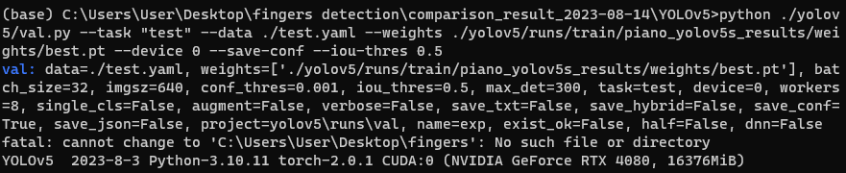

2. Evaluation Metric for Object Detection - YOLOv5 ~ IoU threshold: 0.5
The image below is the command to get YOLOv5 model’s evalutaion metric in cmd.
The image below is the result of the YOLOv5 model’s evalutaion metric.
Precision: 1
Recall: 1
mAP50: 0.995
mAP50-95: 0.819
3

Slide 9
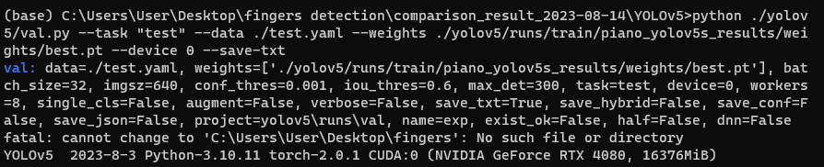
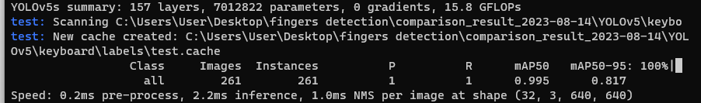
2. Evaluation Metric for Object Detection - YOLOv5 ~ IoU threshold: 0.6
The image below is the command to get YOLOv5 model’s evalutaion metric in cmd.
The image below is the result of the YOLOv5 model’s evalutaion metric.
Precision: 1
Recall: 1
mAP50: 0.995
mAP50-95: 0.817
4

Slide 10
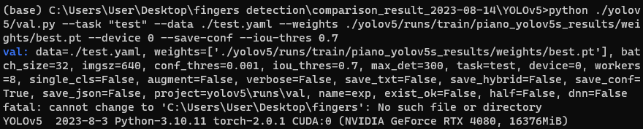

2. Evaluation Metric for Object Detection - YOLOv5 ~ IoU threshold: 0.7
The image below is the command to get YOLOv5 model’s evalutaion metric in cmd.
The image below is the result of the YOLOv5 model’s evalutaion metric.
Precision: 1
Recall: 1
mAP50: 0.995
mAP50-95: 0.814
5

Slide 11
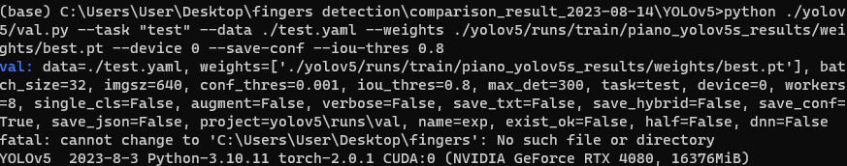

2. Evaluation Metric for Object Detection - YOLOv5 ~ IoU threshold: 0.8
The image below is the command to get YOLOv5 model’s evalutaion metric in cmd.
The image below is the result of the YOLOv5 model’s evalutaion metric.
Precision: 1
Recall: 1
mAP50: 0.995
mAP50-95: 0.811
6

Slide 12
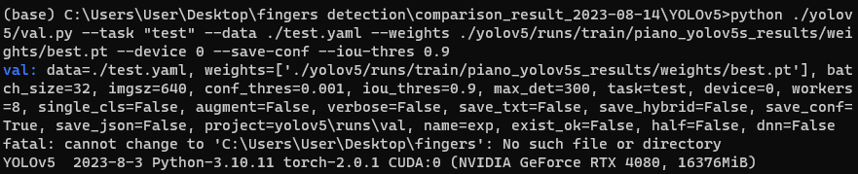

2. Evaluation Metric for Object Detection - YOLOv5 ~ IoU threshold: 0.9
The image below is the command to get YOLOv5 model’s evalutaion metric in cmd.
The image below is the result of the YOLOv5 model’s evalutaion metric.
Precision: 0.995
Recall: 1
mAP50: 0.995
mAP50-95: 0.813
7

Slide 13
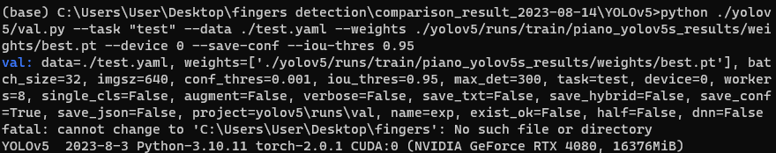

2. Evaluation Metric for Object Detection - YOLOv5 ~ IoU threshold: 0.95
The image below is the command to get YOLOv5 model’s evalutaion metric in cmd.
The image below is the result of the YOLOv5 model’s evalutaion metric.
Precision: 0.951
Recall: 0.989
mAP50: 0.992
mAP50-95: 0.81
8

Slide 14
2. Evaluation Metric for Object Detection
- SSD-MobileNet

Slide 15
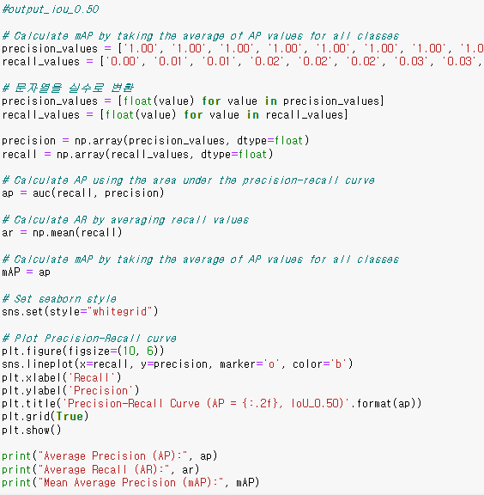

2. Evaluation Metric for Object Detection - SSD-MobileNet
I coded to create a graph about PR curve using numpy, matplotlib, seaborn and scikit-learn.
Used IoU threshold are 0.5, 0.6, 0.7, 0.8, 0.9 and 0.95.
9

Slide 16
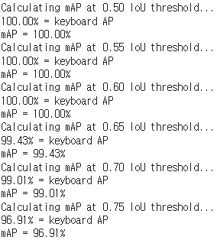
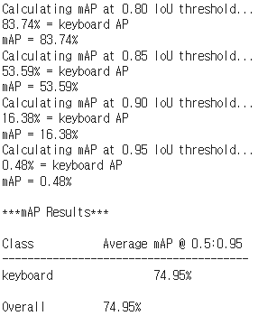
2. Evaluation Metric Summary - SSD-MobileNet
10

Slide 17
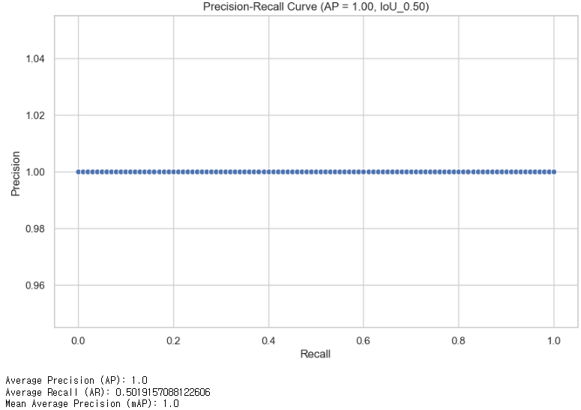
2. Evaluation Metric for Object Detection - SSD ~ IoU threshold: 0.5
The image below is the result of the SSD-MobileNet model’s evalutaion metric.
11

Slide 18
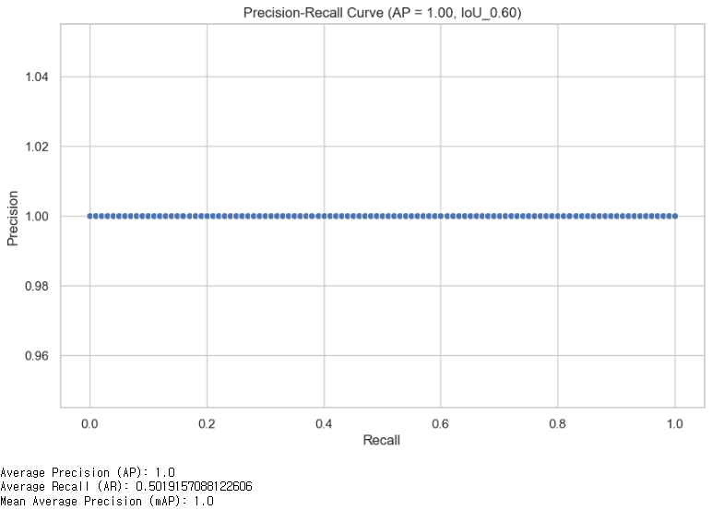
2. Evaluation Metric for Object Detection - SSD ~ IoU threshold: 0.6
The image below is the result of the SSD-MobileNet model’s evalutaion metric.
12

Slide 19
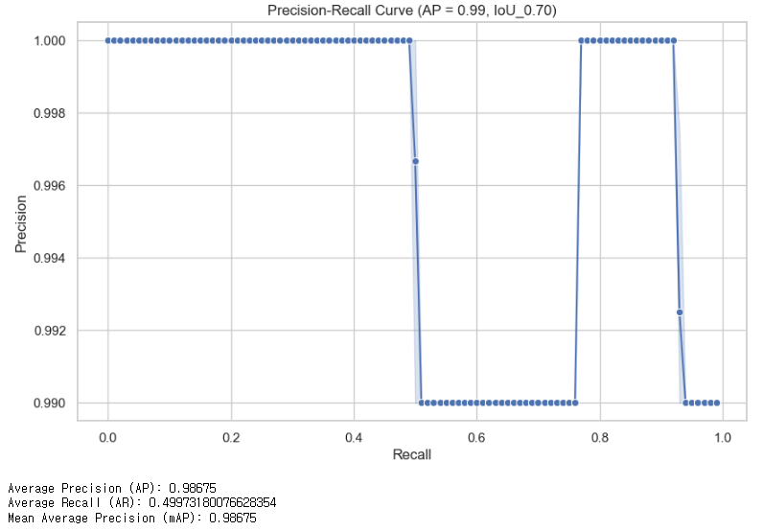
2. Evaluation Metric for Object Detection - SSD ~ IoU threshold: 0.7
The image below is the result of the SSD-MobileNet model’s evalutaion metric.
13

Slide 20
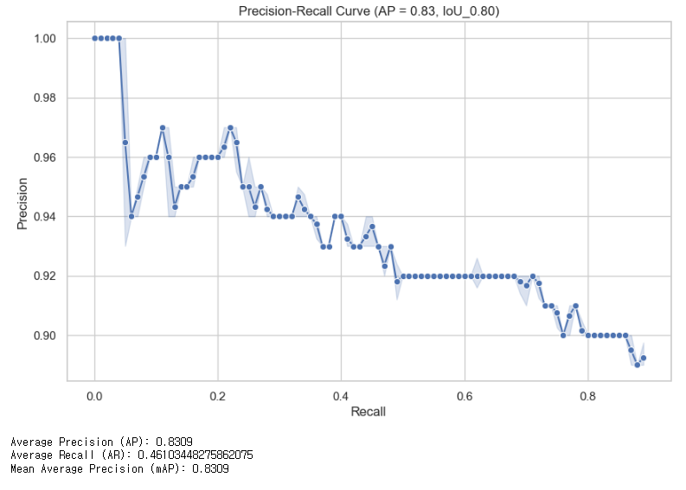
2. Evaluation Metric for Object Detection - SSD ~ IoU threshold: 0.8
The image below is the result of the SSD-MobileNet model’s evalutaion metric.
14

Slide 21
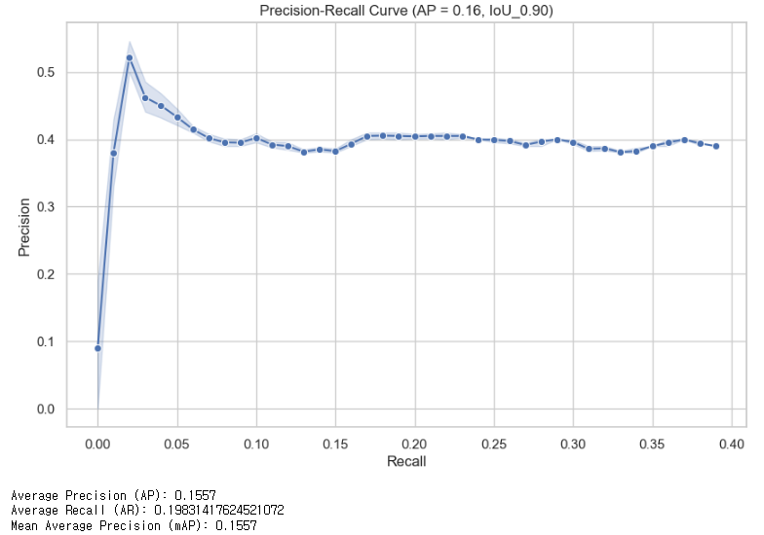
2. Evaluation Metric for Object Detection - SSD ~ IoU threshold: 0.9
The image below is the result of the SSD-MobileNet model’s evalutaion metric.
15

Slide 22
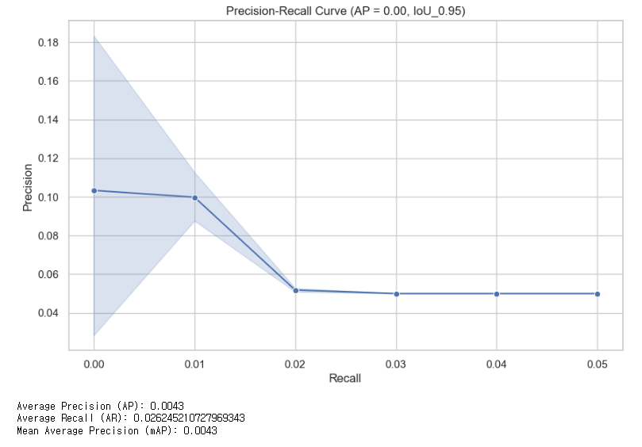
2. Evaluation Metric for Object Detection - SSD ~ IoU threshold: 0.95
The image below is the result of the SSD-MobileNet model’s evalutaion metric.
16

Slide 23
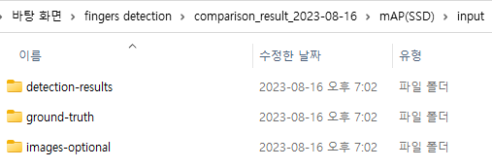
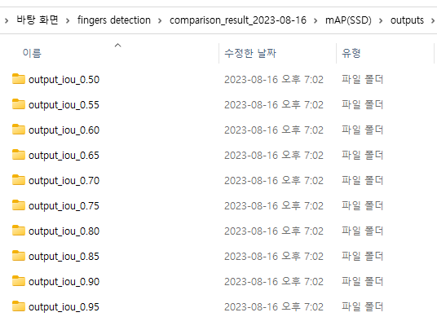
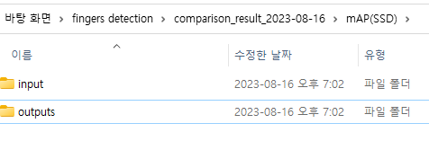
2. Evaluation Metric for Object Detection - SSD-MobileNet
Files about evalution metric of SSD-MobileNet are attached in this folder with the name ‘mAP(SSD).
How to understanding those
The images above are directory structures.
input
detection-result: result files inferenced about test dataset
ground-truth: files labeled about test dataset
images-optional: images about test dataset
outputs: each output files about IoU threshold values
17

Slide 24
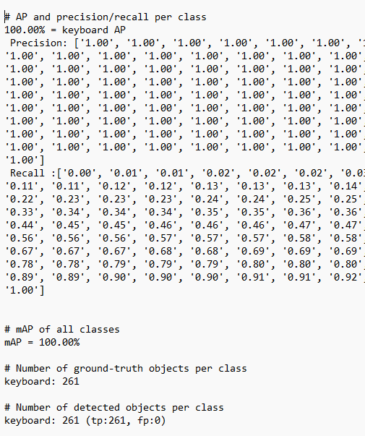
2. Evaluation Metric for Object Detection - SSD-MobileNet
First, We need to enter the outputs directory.
Second, open the output.txt file in the output_iou folder.
This image below is example about IoU threshold 0.5.
Precision List: precision values for test dataset in './input/images-optional'
Recall List: recall values for test dataset in './input/images-optional'
mAP: mAP value found at each IoU value.
* If you want to understand something additionally, please refer to the 'calculate_map_cartucho.py' and ‘main.py’ code attached.
18

Slide 25
3. Comparison the results (PR-Curve)

Slide 26
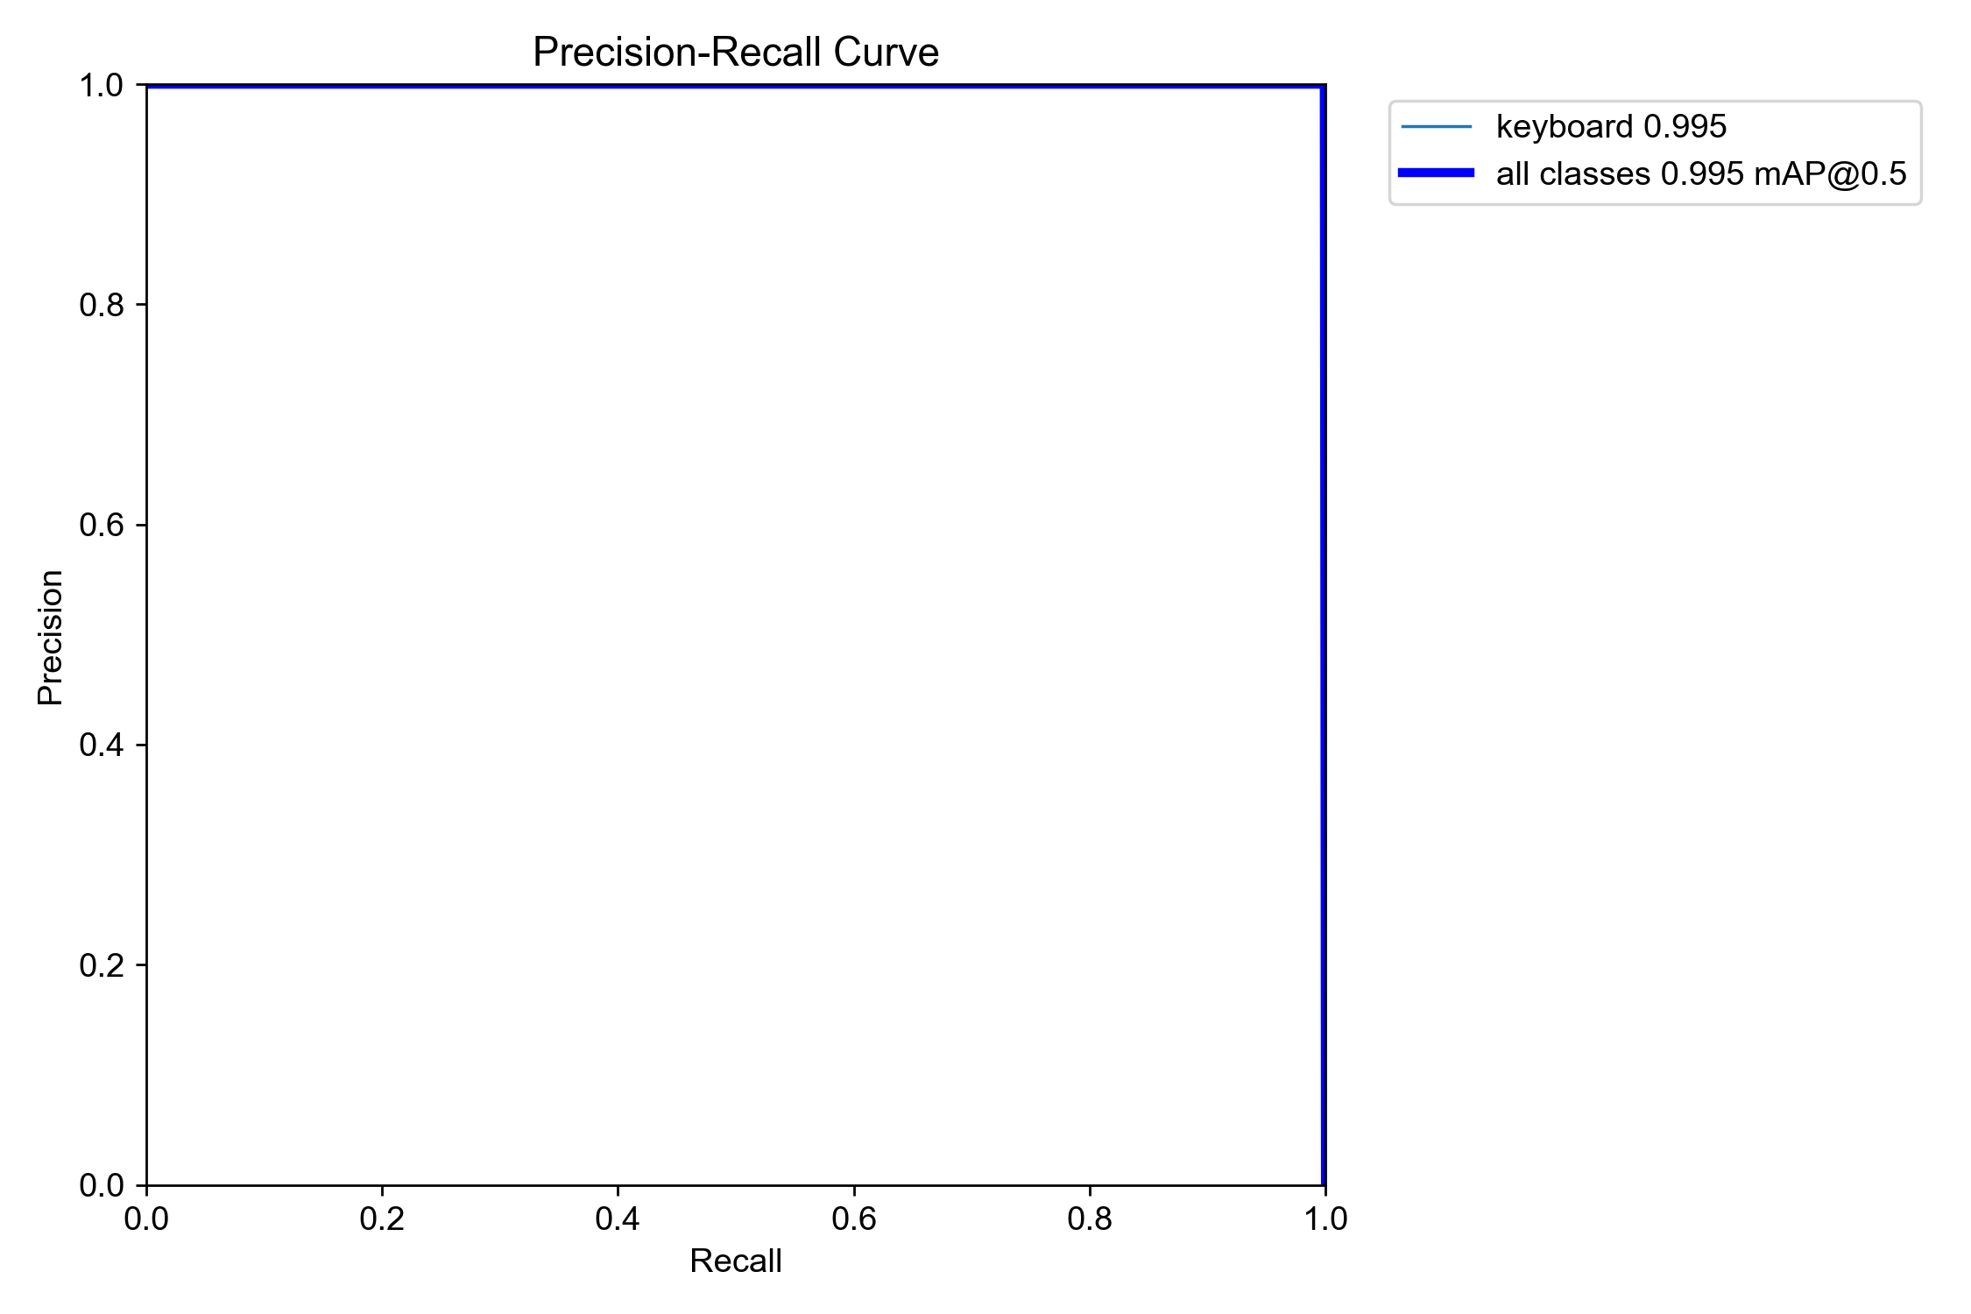
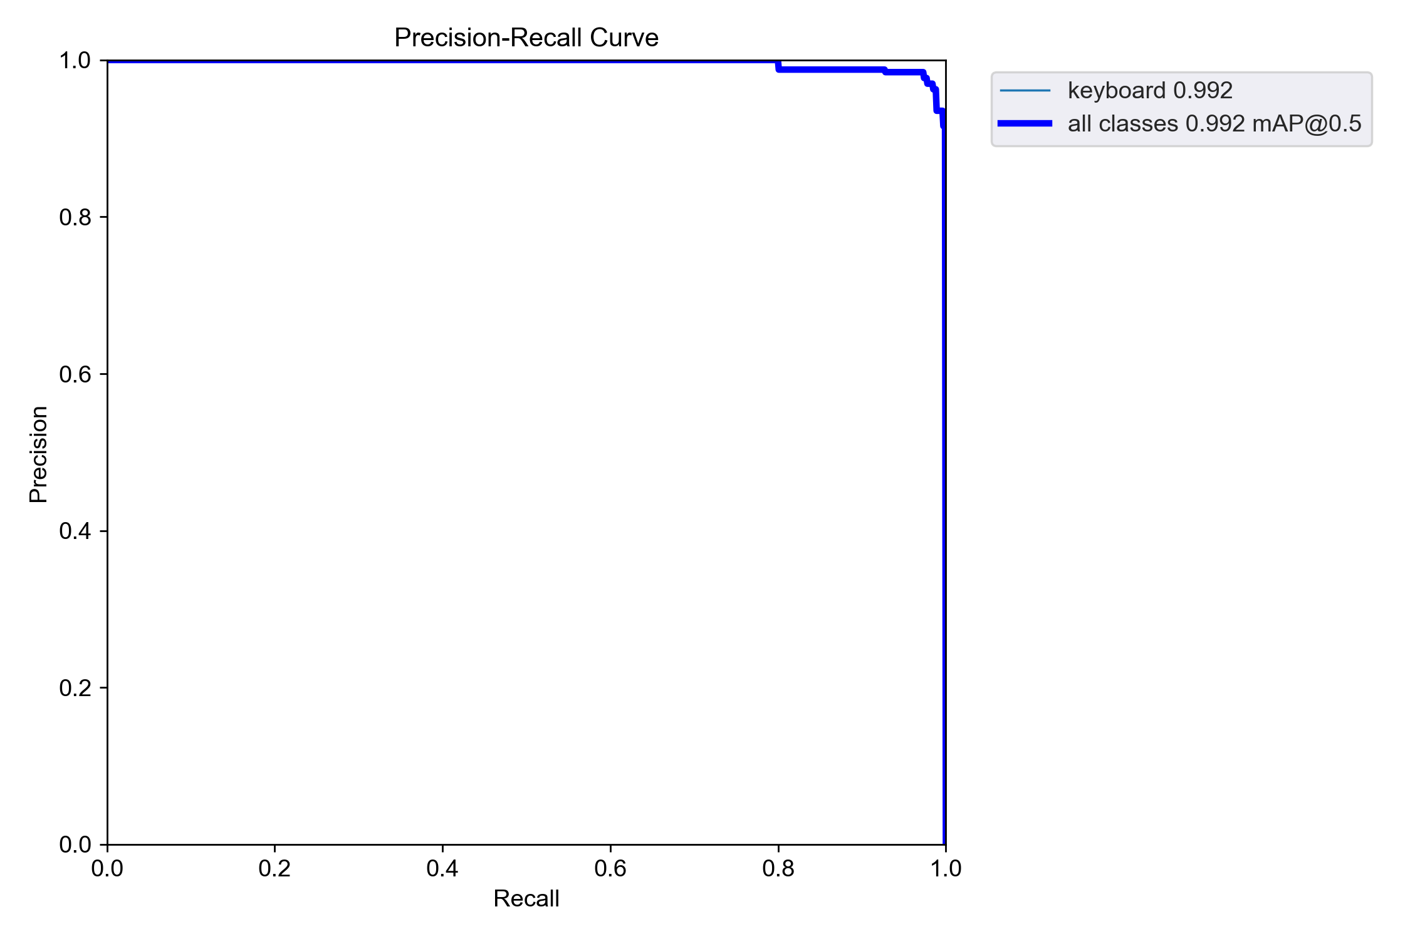
3. Comparison the results (PR-Curve)
YOLOv5 ~ IoU: 0.5
SSD ~ IoU: 0.5
YOLOv5 ~ IoU: 0.95
SSD ~ IoU: 0.95
19

Slide 27
3. Analysis of evalutaion metric results
YOLOv5 & SSD-MobileNet
As explained earlier, I collected 2,605 images from divided in 5 technique related videos. Then I trained the model using these.
Although I split dataset for train, test, and val respectively, For example, elements such as the background are too similar, so I think overfitting occurs. Also, Precision and Recall values are too high.
YOLOv5 vs SSD-MobileNet
I think the model trained YOLOv5 is better than another.
20

